Slide 1
(Mostly) Unsupervised linear models in imaging…
Many of these slides were adapted from: Srinivasa Narasimhan, Todd Zickler, Steven Gortler, Kayvon Fatahalian

Slide 2
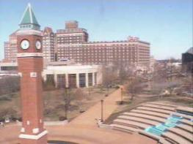
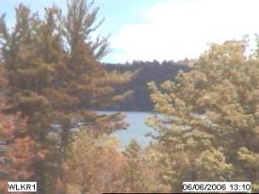
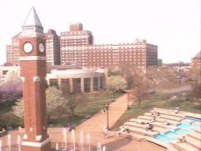
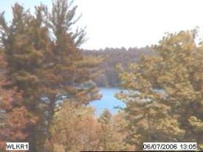
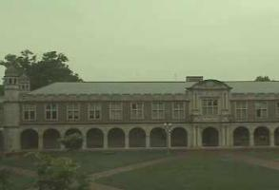
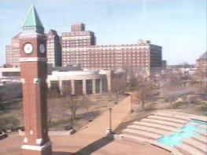
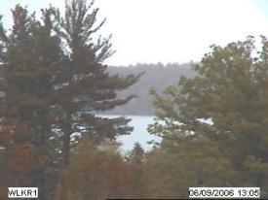
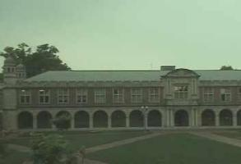
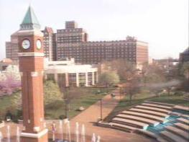
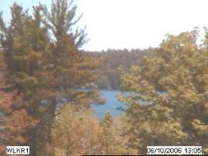
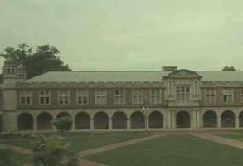
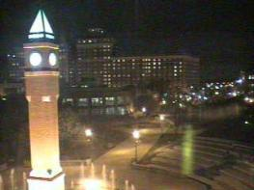
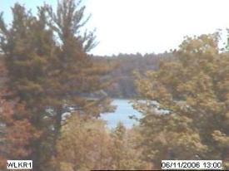
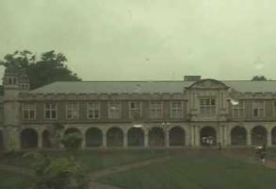
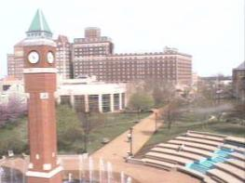
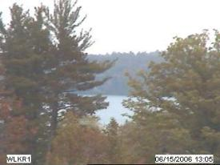
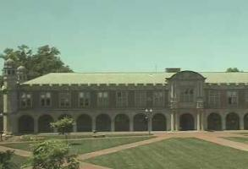
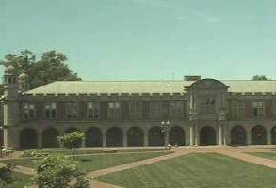
scene tensor factorization
[
]
[
]
[
]
≈
[
]
[
]
[
]
[
]
Dawn
Dusk
Dawn
Dusk

Slide 3
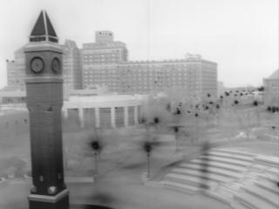
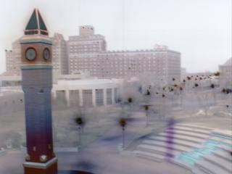
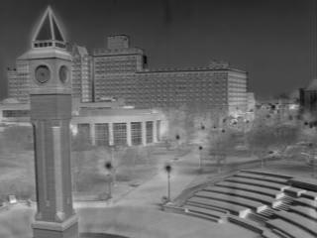
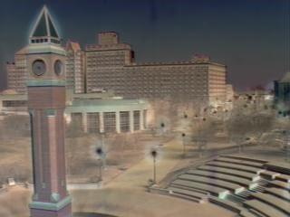
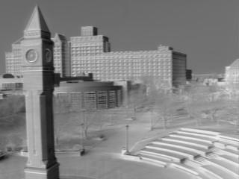
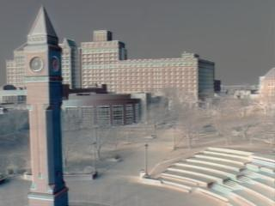
consistent labeling using tensor factorization
R
G
B
Dawn
Dusk

Slide 4
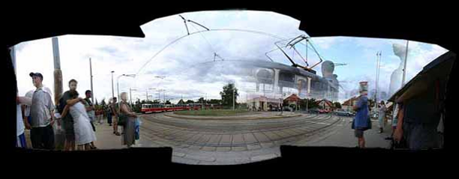
Homographies and Mosaics
© Jeffrey Martin (jeffrey-martin.com)
CS194: Intro to Computer Vision and Comp. Photo
Alexei Efros, UC Berkeley, Fall 2020
with a lot of slides stolen from
Steve Seitz and Rick Szeliski

Slide 5

Why Mosaic?
Are you getting the whole picture?
Compact Camera FOV = 50 x 35°
Slide from Brown & Lowe

Slide 6
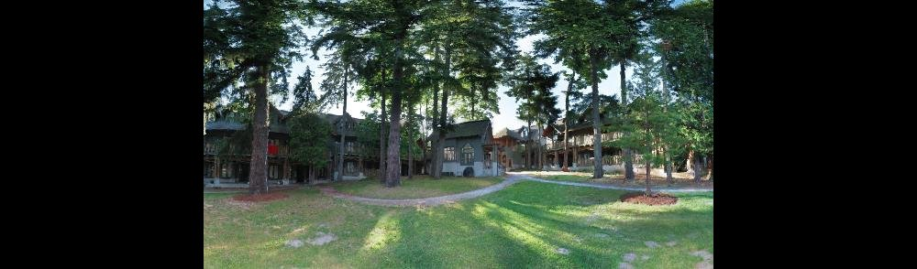
Why Mosaic?
Are you getting the whole picture?
Compact Camera FOV = 50 x 35°
Human FOV = 200 x 135°
Slide from Brown & Lowe

Slide 7
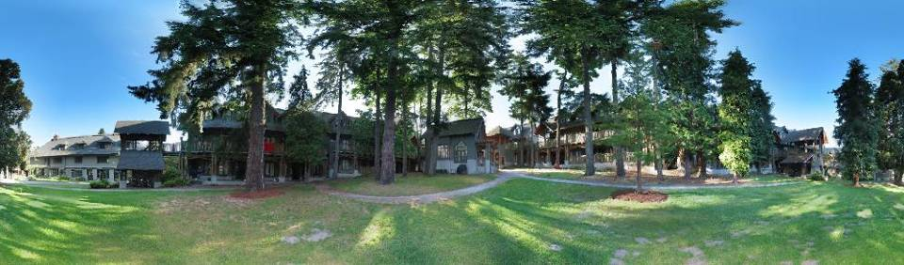
Why Mosaic?
Are you getting the whole picture?
Compact Camera FOV = 50 x 35°
Human FOV = 200 x 135°
Panoramic Mosaic = 360 x 180°
Slide from Brown & Lowe

Slide 8
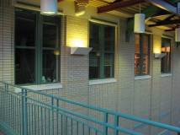
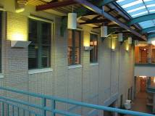
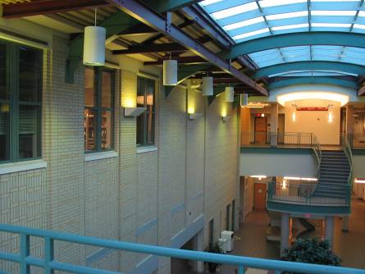
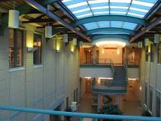
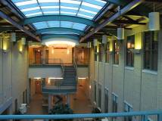
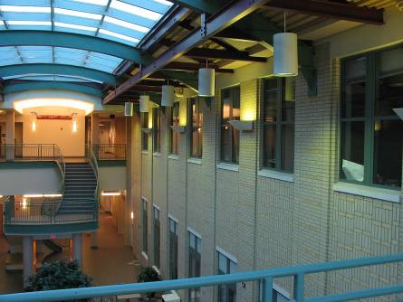
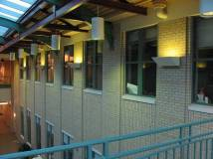
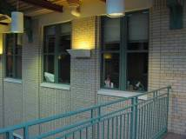
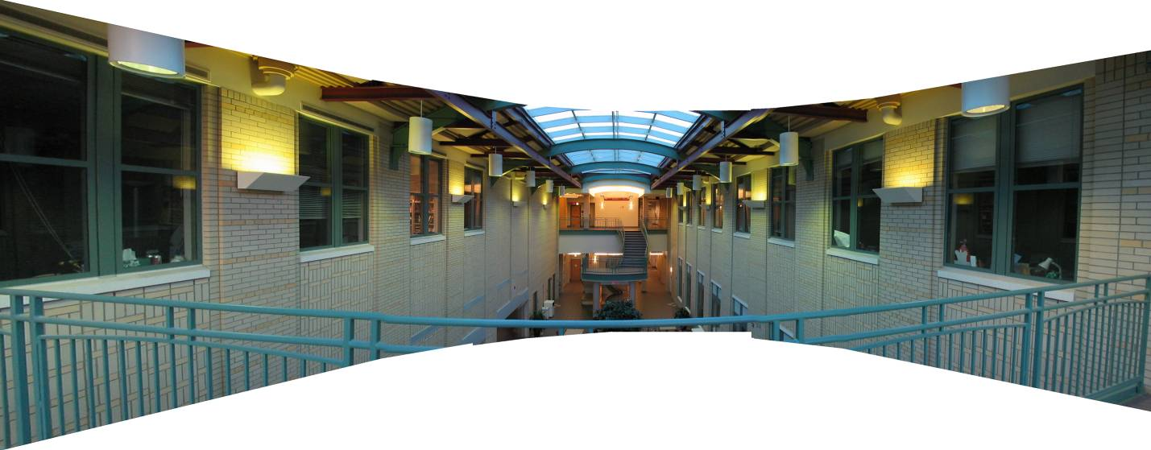
Mosaics: stitching images together
virtual wide-angle camera

Slide 9
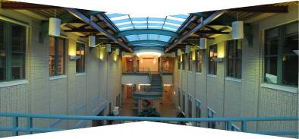
Naïve Stitching
left on top
right on top
Translations are not enough to align the images

Slide 10
A pencil of rays contains all views
real
camera
synthetic
camera
Can generate any synthetic camera view
as long as it has the same center of projection!

Slide 11
Image reprojection
mosaic PP
The mosaic has a natural interpretation in 3D
The images are reprojected onto a common plane
The mosaic is formed on this plane
Mosaic is a synthetic wide-angle camera

Slide 12
How to do it?
Basic Procedure
Take a sequence of images from the same position
Rotate the camera about its optical center
Compute transformation between second image and first
Transform the second image to overlap with the first
Blend the two together to create a mosaic
If there are more images, repeat
…but wait, why should this work at all?
What about the 3D geometry of the scene?
Why aren’t we using it?

Slide 13
Image reprojection
Basic question
How to relate two images from the same camera center?
how to map a pixel from PP1 to PP2
PP2
Answer
Cast a ray through each pixel in PP1
Draw the pixel where that ray intersects PP2
PP1
But don’t we need to know the geometry
of the two planes in respect to the eye?
Observation:
Rather than thinking of this as a 3D reprojection,
think of it as a 2D image warp from one image to another

Slide 14
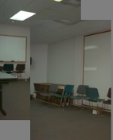
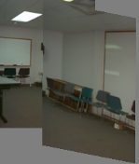
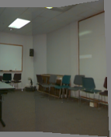
Which t-form is the right one for warping PP1 into PP2?
e.g. translation, Euclidean, affine, projective
Translation
Affine
Perspective
2 unknowns
6 unknowns
8 unknowns

Slide 15
Homography
A: Projective – mapping between any two PPs with the same center of projection
rectangle should map to arbitrary quadrilateral
parallel lines aren’t
but must preserve straight lines
same as: unproject, rotate, reproject
called Homography
PP2
p’
H
p
PP1
To apply a homography H
Compute p’ = Hp (regular matrix multiply)
Convert p’ from homogeneous to image coordinates

Slide 16
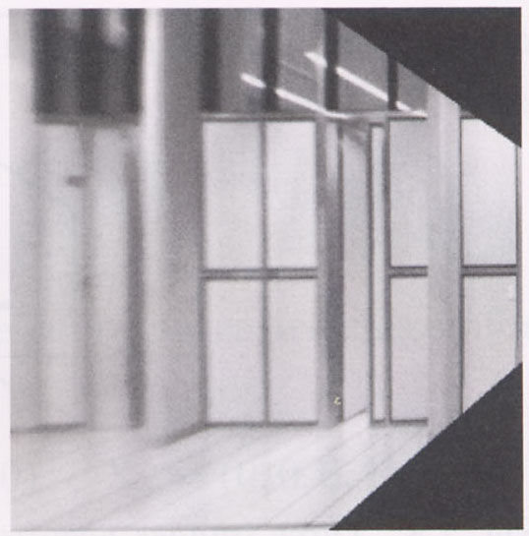
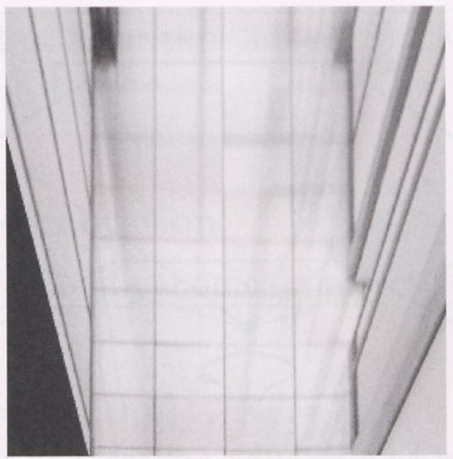
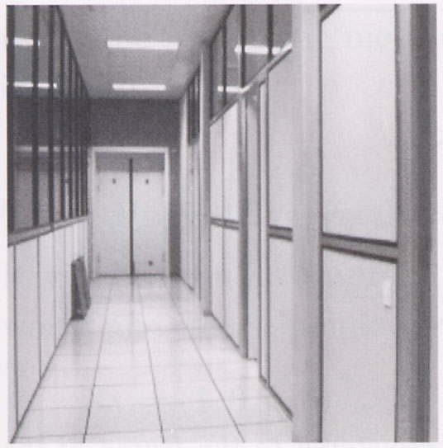
Image warping with homographies
image plane in front
image plane below
black area
where no pixel
maps to

Slide 17
Image rectification
p’
p
To unwarp (rectify) an image
Find the homography H given a set of p and p’ pairs
How many correspondences are needed?
Tricky to write H analytically, but we can solve for it!
Find such H that “best” transforms points p into p’
Use least-squares!

Slide 18
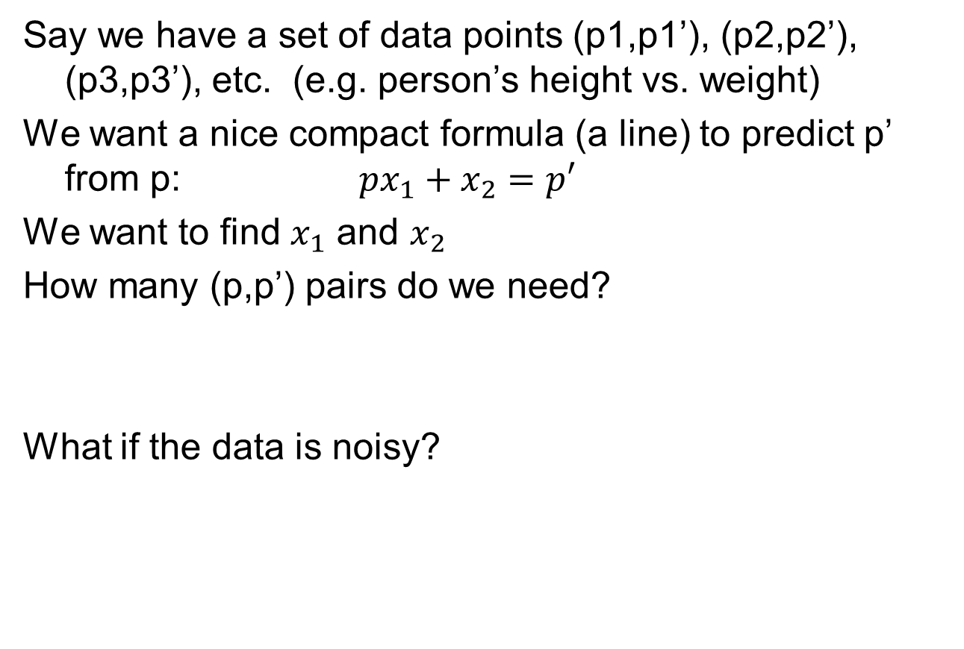
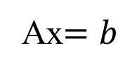
Least Squares Example

Slide 19
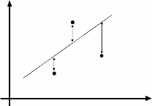
Least Squares Example
overconstrained

Slide 20
Least-Squares
d
Solve:
A x = b
(N,d)(d,1) = (N,1)
Normal equations
A^{T}A x = A^{T}b
(d,N)(N,d)(d,1) = (d,N)(N,1)
Solution:
x = (A^{T}A)⁻¹A^{T}b
A
N
rank(A)≤min(d,N)
assume rank(A)=d
implies rank(A^{T}A)=d
A^{T}A is invertible

Slide 21
Solving for homographies
p’ = Hp
Can set scale factor i=1. So, there are 8 unkowns.
Set up a system of linear equations:
Ah = b
where vector of unknowns h = [a,b,c,d,e,f,g,h]^{T}
Need at least 8 eqs, but the more the better…
Solve for h. If overconstrained, solve using least-squares:
Can be done in Matlab using “\” command
see “help lmdivide”

Slide 22
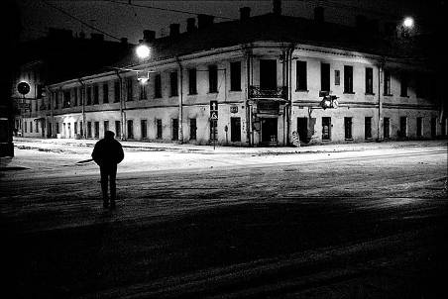
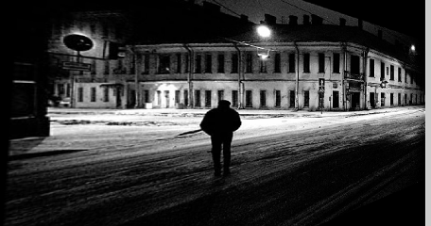
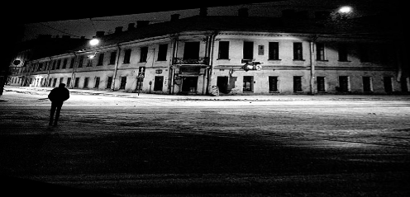
Fun with homographies
Original image
St.Petersburg
photo by A. Tikhonov
Virtual camera rotations

Slide 23
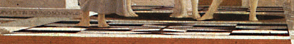


Analysing patterns and shapes
What is the shape of the b/w floor pattern?
Homography
The floor (enlarged)
Automatically
rectified floor
Slide from Criminisi

Slide 24

Analysing patterns and shapes
Automatic rectification
From Martin Kemp The Science of Art
(manual reconstruction)
2 patterns have been discovered !
Slide from Criminisi

Slide 25


Analysing patterns and shapes
What is the (complicated)
shape of the floor pattern?
Automatically rectified floor
St. Lucy Altarpiece, D. Veneziano
Slide from Criminisi

Slide 26

Analysing patterns and shapes
Automatic
rectification
From Martin Kemp, The Science of Art
(manual reconstruction)
Slide from Criminisi

Slide 27

Panoramas
Pick one image (red)
Warp the other images towards it (usually, one by one)
blend

Slide 28
changing camera center
Does it still work?
synthetic PP
PP1
PP2

Slide 29

Planar scene (or far away)
PP3
PP1
PP2
PP3 is a projection plane of both centers of projection, so we are OK!
This is how big aerial photographs are made

Slide 30


Planar mosaic

Slide 31




Julian Beever: Manual Homographies
http://users.skynet.be/J.Beever/pave.htm

Slide 32

Holbein, The Ambassadors

Slide 33
Programming Project #5 (part 1)
Homographies and Panoramic Mosaics
Capture photographs (and possibly video)
Might want to use tripod
Compute homographies (define correspondences)
will need to figure out how to setup system of eqs.
(un)warp an image (undo perspective distortion)
Produce panoramic mosaics (with blending)
Do some of the Bells and Whistles

Slide 34


Bells and Whistles
Blending and Compositing
use homographies to combine images or video and images together in an interesting (fun) way. E.g.
put fake graffiti on buildings or chalk drawings on the ground
replace a road sign with your own poster
project a movie onto a building wall
etc.

Slide 35
Bells and Whistles
Virtual Camera rorate
Similar to face morphing, produce a video of virtual camera rotation from a single image
Can also do it for translation, if looking at a planar object
Other interesting ideas?
talk to me

Slide 36






From previous year’s classes
Ben Hollis, 2004
Ben Hollis, 2004
Eunjeong Ryu (E.J), 2004
Matt Pucevich , 2004

Slide 37
Bells and Whistles
Capture creative/cool/bizzare panoramas
Example from UW (by Brett Allen):
Ever wondered what is happening inside your fridge while you are not looking?
Capture a 360 panorama (quite tricky…)

Slide 38

Example homography final project

Slide 39




Setting alpha: simple averaging
Alpha = .5 in overlap region

Slide 40




Setting alpha: center seam
Distance
Transform
bwdist
Alpha = logical(dtrans1>dtrans2)

Slide 41


Setting alpha: blurred seam
Distance
transform
Alpha = blurred

Slide 42


Simplification: Two-band Blending
Brown & Lowe, 2003
Only use two bands: high freq. and low freq.
Blends low freq. smoothly
Blend high freq. with no smoothing: use binary alpha

Slide 43


2-band “Laplacian Stack” Blending
Low frequency (λ > 2 pixels)
High frequency (λ < 2 pixels)

Slide 44

Linear Blending

Slide 45

2-band Blending

